Slide 1
Database Management Systems
LECTURE -1

Slide 2
What is a Database

Slide 3
Database Definitions
A database is a shared collection of logically related data that is stored to meet the requirements of different users of an organization

Slide 4
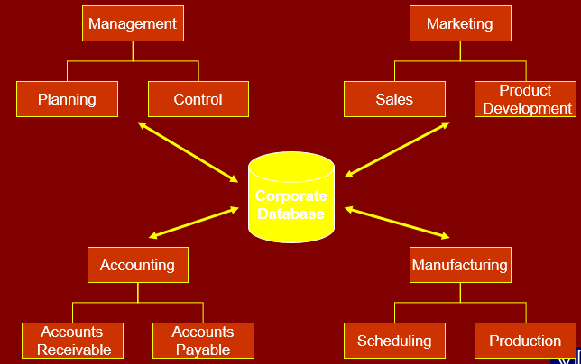
The concept of a shared organizational database

Slide 5
Database System Important Terms
Schema
Database Application
Database Management system(DBMS)

Slide 6
Data As Resource
Resource
Any asset that is of value to an organization and that incurs cost

Slide 7
Levels of Data
Real-world data ( Entity)
Metadata ( Record Type)
Data Occurrence ( Record of an Entity)

Slide 8
Database Users
Application Programmers
End Users
Naïve
Sophisticated

Slide 9
Database Users
Database Administrator (DBA)
A person who has central control over data and programs that access this data

Slide 10
Functions of DBA
Schema definition
Granting data access
Routine Maintenance
Backups
Monitoring disk space
Monitoring jobs running

Slide 11
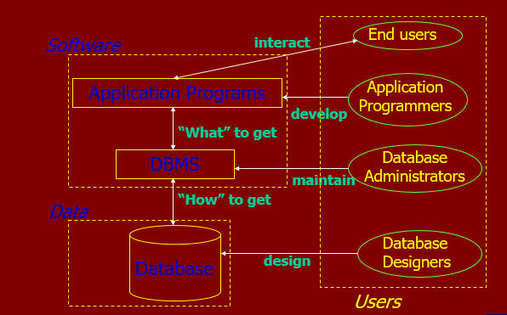
Data, Database, Data Model and DBMS

Slide 12
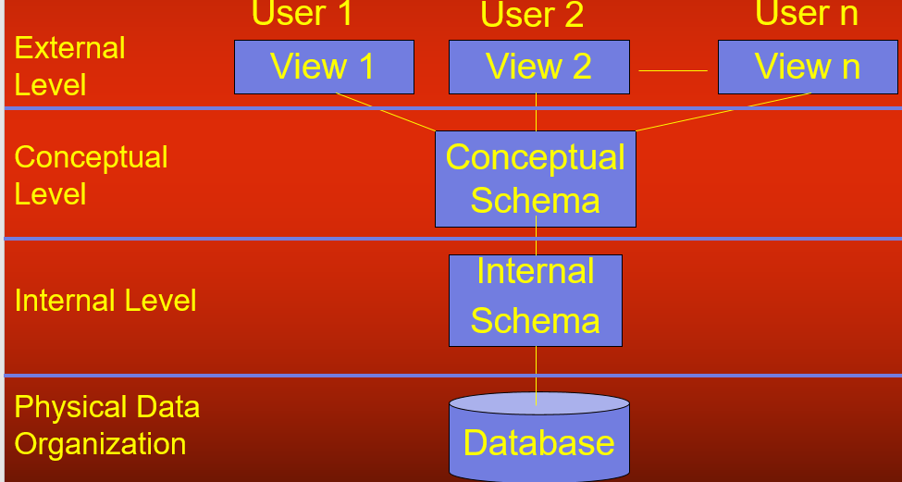
The Three-Level Architecture

Slide 13
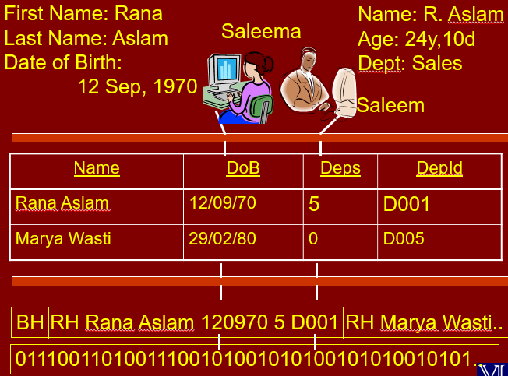

Slide 14
Database Model
Database model defines the logical design of data.
Database model describes the relation between different
parts of data.
There are three database models:
Hierarchical Model
Network Model
Relational Model

Slide 15
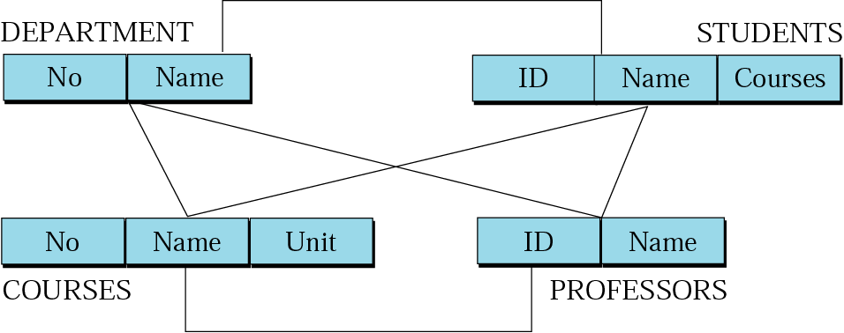
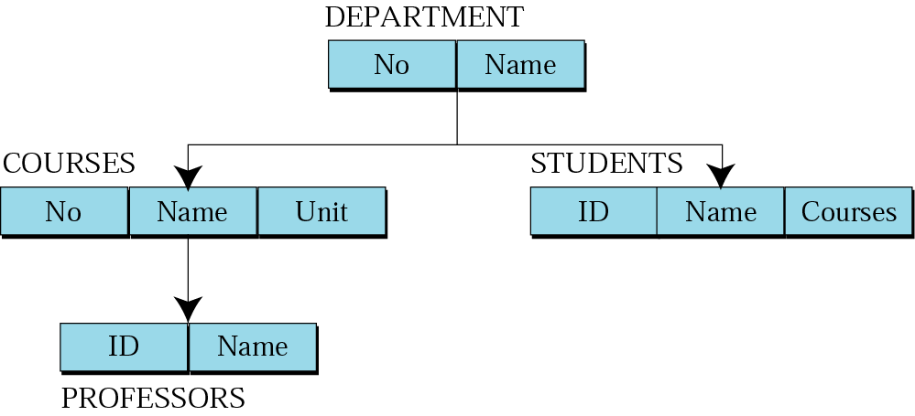
Database Model
Network Model
Hierarchical Model

Slide 16
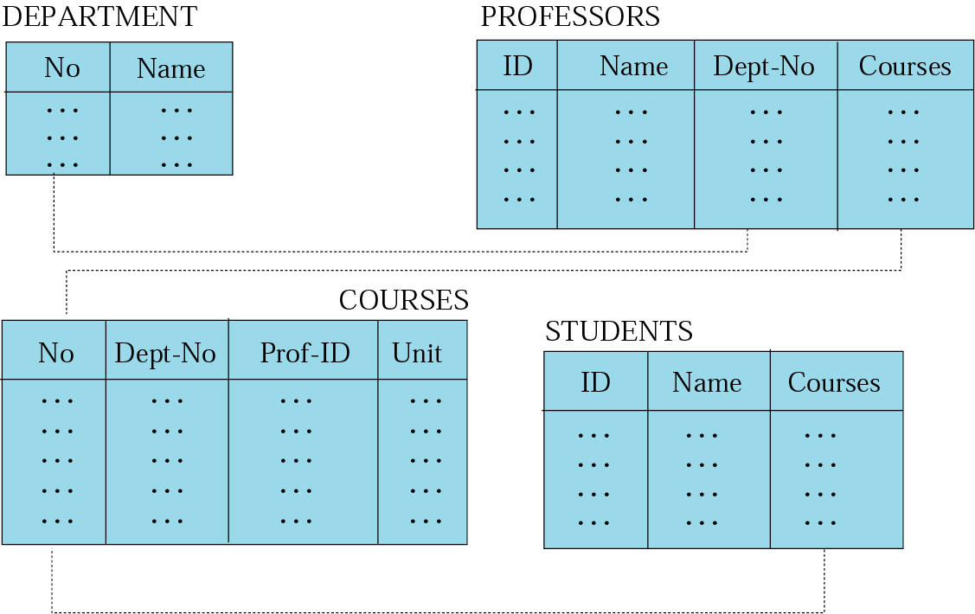
Relational Model
Data are organized in two dimensional tables (relations)
Tables related to each other
Relational Database Management System (RDBMS) are more common model used today

Slide 17
Basics of RDM
Relations physically represented as tables
Table is a two dimensional representation of a relation
Consists of rows and columns
Columns represent attributes and rows represent records
Rows, records and tuples all these terms are used interchangeably

Slide 18
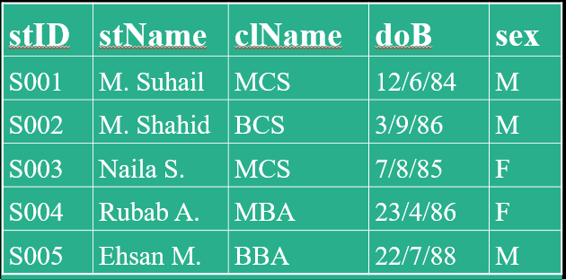
Basic Properties of a Table
Each cell of a table contains atomic/single value
Each column has a distinct name; the name of the attribute it represents
The values of the attributes come from the same domain
The order of the columns is immaterial
The order of the rows is immaterial
Each row/tuple/record is distinct, no two rows can be same

Slide 19
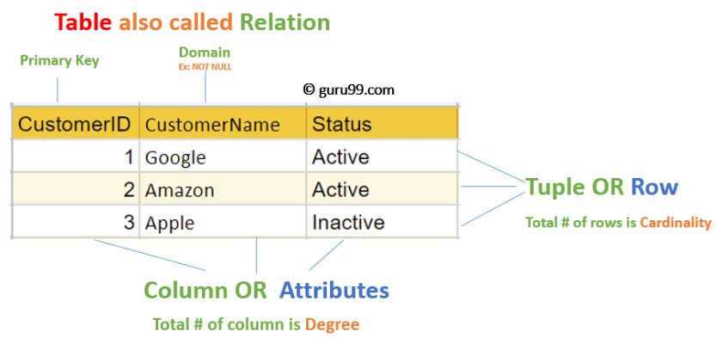
A Table

Slide 20
RM Concept in DBMS
Attribute: Each column in a Table. Attributes are the properties which define a relation. e.g., Student_Rollno, NAME,etc
Tables – In the Relational model the, relations are saved in the table format. It is stored along with its entities. A table has two properties rows and columns. Rows represent records and columns represent attributes.
Tuple – It is nothing but a single row of a table, which contains a single record.
Relation Schema: A relation schema represents the name of the relation with its attributes.
Degree: The total number of attributes which in the relation is called the degree of the relation.
Cardinality: Total number of rows present in the Table.
Column: The column represents the set of values for a specific attribute.
Relation instance – Relation instance is a finite set of tuples in the RDBMS system. Relation instances never have duplicate tuples

Slide 21
RM Concept in DBMS
Relation key – Every row has one, two or multiple attributes, which is called relation key.
Attribute domain – Every attribute has some pre-defined value and scope which is known as attribute domain
Relational database schema – A set of relation schemas ,each with a distinct name.
Example: If R1,R2,R3…..Rn are set of relations, then we can write RDBMS as
R={ R1,R2,R3…..Rn}

Slide 22
Relational Integrity Constraints
Relational Integrity constraints in DBMS are referred to conditions which must be present for a valid relation. These Relational constraints in DBMS are derived from the rules in the mini-world that the database represents.
There are many types of Integrity Constraints in DBMS. Constraints on the Relational database management system is mostly divided into three main categories are:
Domain Constraints
Key Constraints
Referential Integrity Constraints

Slide 23
Domain Constraints
Domain constraints can be violated if an attribute value is not appearing in the corresponding domain or it is not of the appropriate data type.
Domain constraints specify that within each tuple, and the value of each attribute must be unique. This is specified as data types which include standard data types integers, real numbers, characters, Booleans, variable length strings, etc.
Example:
create DOMAIN CustomerName
check( value not null)

Slide 24
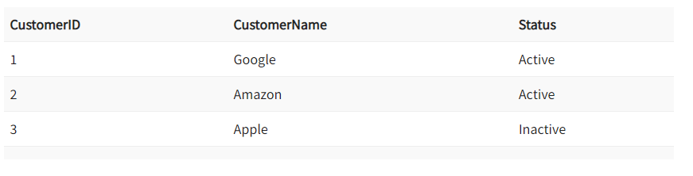
Key Constraints
An attribute that can uniquely identify a tuple in a relation is called the key of the table. The value of the attribute for different tuples in the relation has to be unique.
Example: In the given table, CustomerID is a key attribute of Customer Table. It is most likely to have a single key for one customer, CustomerID =1 is only for the CustomerName =” Google”.

Slide 25
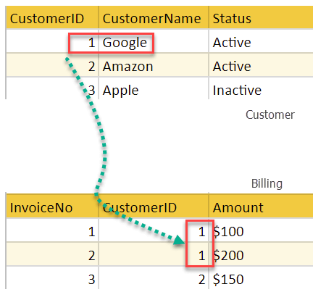
Referential Integrity Constraints
Referential Integrity constraints in DBMS are based on the concept of Foreign Keys. A foreign key is an important attribute of a relation which should be referred to in other relationships. Referential integrity constraint state happens where relation refers to a key attribute of a different or same relation. However, that key element must exist in the table.
Example :
In the above example, we have 2 relations, Customer and Billing.
Tuple for CustomerID =1 is referenced twice in the relation Billing. So we know CustomerName=Google has billing amount $300

Slide 26
Advantages of Relational Database Model
Simplicity: A Relational data model in DBMS is simpler than the hierarchical and network model.
Easy to use: The Relational model in DBMS is easy as tables consisting of rows and columns are quite natural and simple to understand
Data independence: The Structure of Relational database can be changed without having to change any application

Slide 27
Database Management Systems
LECTURE -1
END

